Slide 1




GRADE 9-10 · AP PRECALCULUS · UNIT 1
Topic 1.8
Rational Functions
and Zeros
Journey of 6 stations, 60 minutes
Polynomial and Rational Functions
Mr Malek Thiab
FAITH, RIGHTEOUSNESS AND WISDOM
Notes:
Speaker notes: Welcome to Topic 1.8: Rational Functions and Zeros.
Timing: 60 minutes (Diagnose 6, Targeted Instruction 18, Practice 12, Production 12, Mastery Gate 6, Smart Production 6). For a 40-minute class scale every station by two thirds.
The journey map on the next slide shows the six stations; in slideshow mode the Morph transition zooms the station circles into the breadcrumb at the top of every later slide.

Slide 2


Today's journey
Six stations. Each one zooms in as we arrive.
Targeted Instruction
18 min
Production
12 min
Smart Production
6 min
2
4
6
1
3
5
Diagnose
6 min
Practice
12 min
Mastery Gate
6 min
FAITH, RIGHTEOUSNESS AND WISDOM
Notes:
Speaker notes: This is the whole map. Walk it left to right: Diagnose (what we already know), Targeted Instruction (Zeros of a rational function; Rewrite first, then find the zeros; Sign charts and inequalities), Practice (Practice, Apply, Investigate), Production (break-even at a tile studio in Lisbon), Mastery Gate (three questions to pass), Smart Production (create, then Time to Check).
In slideshow mode the Morph transition animates these circles shrinking into the breadcrumb on later slides; without Morph the slides fade.
Ask the class which station they think will be hardest.

Slide 3
What we are learning
OBJECTIVES
VOCABULARY
Determine the zeros of rational functions.
zero
rational function
numerator
denominator
domain
hole
vertical asymptote
endpoint
inequality
sign chart
STANDARDS
LO 1.8.A Determine the zeros of rational functions.
LO 1.8.A
FAITH, RIGHTEOUSNESS AND WISDOM
Mr Malek Thiab · 3
Notes:
Speaker notes: Read the objectives aloud one at a time and have students say which one they feel least sure about.
Vocabulary used today: zero, rational function, numerator, denominator, domain, hole, vertical asymptote, endpoint, inequality, sign chart.
Standards are listed on this slide.
The essential question and mathematical practices are not shown because they are not in the project documents; add them from the curriculum map if you want them displayed.

Slide 4

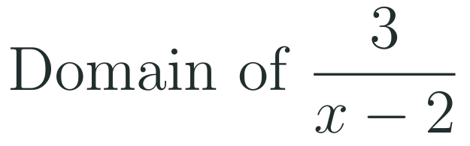
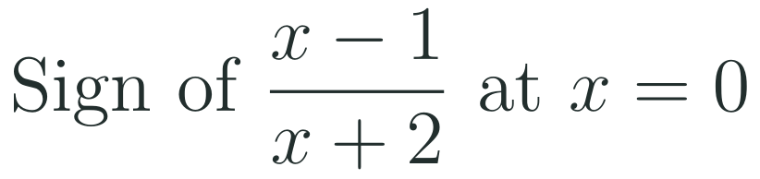
1
2
3
4
5
6
STATION 1 · DIAGNOSE · 6 MIN
Start here: three quick checks
1
2
3
Done when
All three answers are written without a calculator, and you can say what makes a fraction undefined and what makes it zero.
LO 1.8.A
FAITH, RIGHTEOUSNESS AND WISDOM
Mr Malek Thiab · 4
Notes:
Speaker notes (Diagnose, 6 min, no calculator):
Speaker notes (Diagnose, 6 min, no calculator).
Solutions: Q1 x^2 - x - 12 = (x - 4)(x + 3), because -4 and 3 multiply to -12 and add to -1. Q2 the denominator x - 2 is zero when x = 2, so the domain is all real numbers except 2. Q3 at x = 0: (0 - 1)/(0 + 2) = -1/2, which is negative.
Verbal misconceptions: 'factor pairs only need the right product' (check the sum); 'a fraction is zero when the denominator is zero' (that makes it undefined); 'the sign is positive because the numbers look small'.
Adaptive routing: if more than 30% miss Q1, route to slide 5 (factor first). If more than 30% miss Q2, route to slide 5 Example B (the domain decides). If more than 30% miss Q3, route to slide 7 (sign charts).

Slide 5

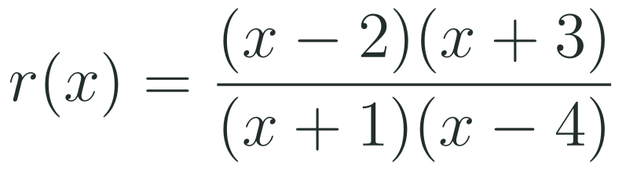
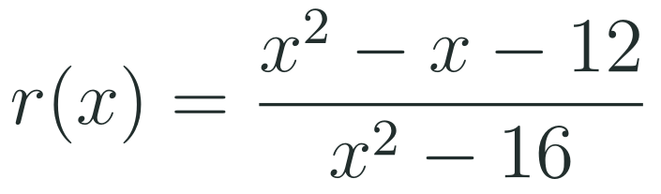
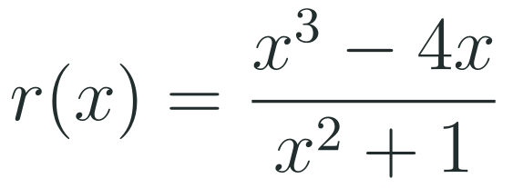
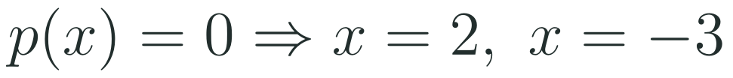
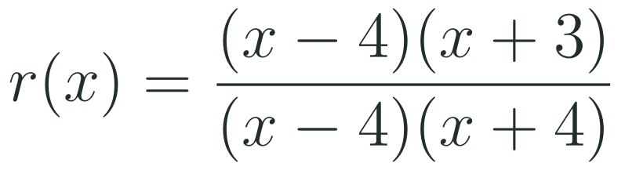
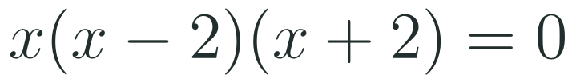
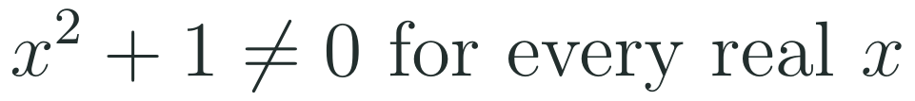



1
2
3
4
5
6
STATION 2 · TARGETED INSTRUCTION · 18 MIN
Zeros of a rational function
EXAMPLE A
EXAMPLE B
EXAMPLE C
LO 1.8.A
FAITH, RIGHTEOUSNESS AND WISDOM
Mr Malek Thiab · 5
Notes:
Speaker notes (Targeted Instruction, block 1 of 3):
Speaker notes (Targeted Instruction, block 1 of 3, LO 1.8.A). Source: AP Precalculus Course and Exam Description (College Board), read via web fetch. EK 1.8.A.1: 'The real zeros of a rational function correspond to the real zeros of the numerator for such values in its domain.'
Worked solutions: Example A: the numerator (x - 2)(x + 3) is zero at x = 2 and x = -3. The denominator at x = 2 is (3)(-2) = -6, and at x = -3 it is (-2)(-7) = 14, so neither value is excluded: zeros -3 and 2. Example B: x^2 - x - 12 = (x - 4)(x + 3) and x^2 - 16 = (x - 4)(x + 4). The numerator is zero at x = 4 and x = -3, but the denominator is also zero at x = 4, so 4 is not in the domain and is not a zero; the graph has a hole at (4, 7/8). The only zero is x = -3. Example C: x^3 - 4x = x(x^2 - 4) = x(x - 2)(x + 2). The denominator x^2 + 1 is at least 1, so it is never zero and all three numerator zeros count: -2, 0, 2.
Verbal misconceptions: 'every zero of the numerator is a zero of the function' (check the domain); 'a zero of the denominator is a zero of the function'; 'a denominator with no real zeros means no zeros at all'.
Adaptive routing: if more than 30% miss Gate Q1, return to this slide and redo Example B aloud, stating the domain before the zeros.

Slide 6

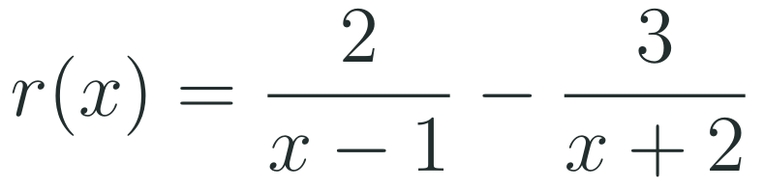
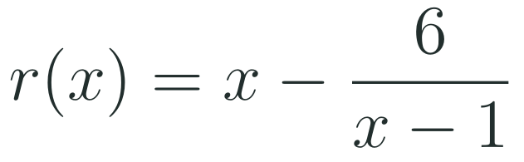
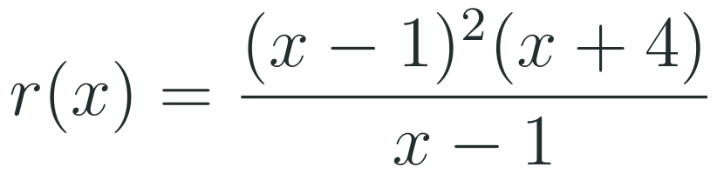
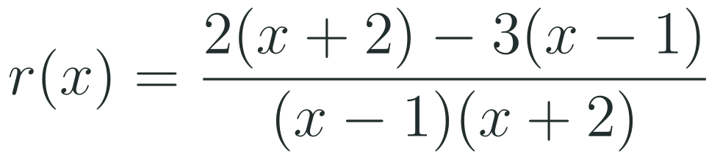
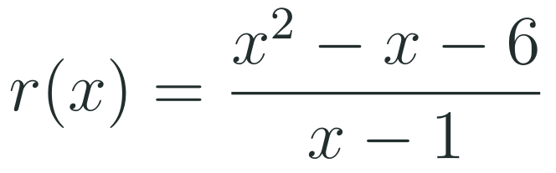
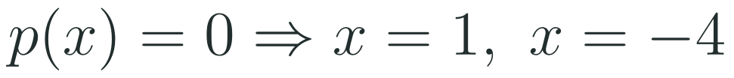
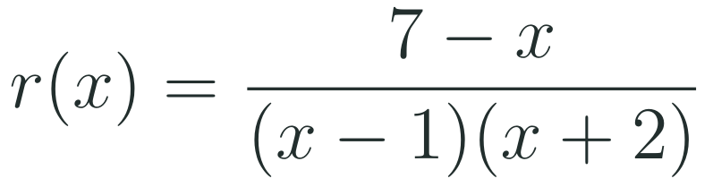
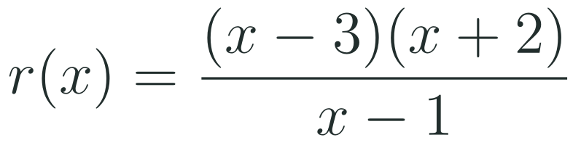
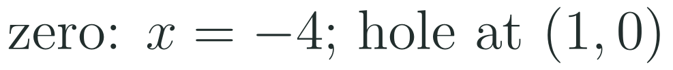


1
2
3
4
5
6
STATION 2 · TARGETED INSTRUCTION · 18 MIN
Rewrite first, then find the zeros
EXAMPLE A
EXAMPLE B
EXAMPLE C
LO 1.8.A
FAITH, RIGHTEOUSNESS AND WISDOM
Mr Malek Thiab · 6
Notes:
Speaker notes (Targeted Instruction, block 2 of 3):
Speaker notes (Targeted Instruction, block 2 of 3, LO 1.8.A). Zeros are read from the numerator of a single fraction, so a sum or difference must be combined first (EK 1.8.A.1).
Worked solutions: Example A: common denominator (x - 1)(x + 2): 2(x + 2) - 3(x - 1) = 2x + 4 - 3x + 3 = 7 - x. The numerator is zero at x = 7, and the denominator there is (6)(9) = 54, not zero, so the zero is x = 7. Check: 2/6 - 3/9 = 1/3 - 1/3 = 0. Example B: x - 6/(x - 1) = (x(x - 1) - 6)/(x - 1) = (x^2 - x - 6)/(x - 1) = (x - 3)(x + 2)/(x - 1). The numerator is zero at 3 and -2, and the denominator is -2 at x = 3 and -3 at x = -2, so both are zeros. Check: r(3) = 3 - 6/2 = 0; r(-2) = -2 - 6/(-3) = 0. Example C: the numerator (x - 1)^2 (x + 4) is zero at x = 1 and x = -4, but r is undefined at x = 1 because the denominator is zero. So x = 1 is not in the domain and not a zero; the simplified form (x - 1)(x + 4) shows the graph passes through (1, 0) with an open circle there (a hole on the x-axis). The only zero is x = -4.
Verbal misconceptions: 'set each fraction equal to zero separately'; 'subtract the numerators 2 - 3 and ignore the denominators'; 'a hole on the x-axis is still a zero'.
Adaptive routing: if more than 30% miss Gate Q2, return to this slide and redo Example A, writing the common denominator first. If students list x = 1 in Example C, return to slide 5 Example B.

Slide 7
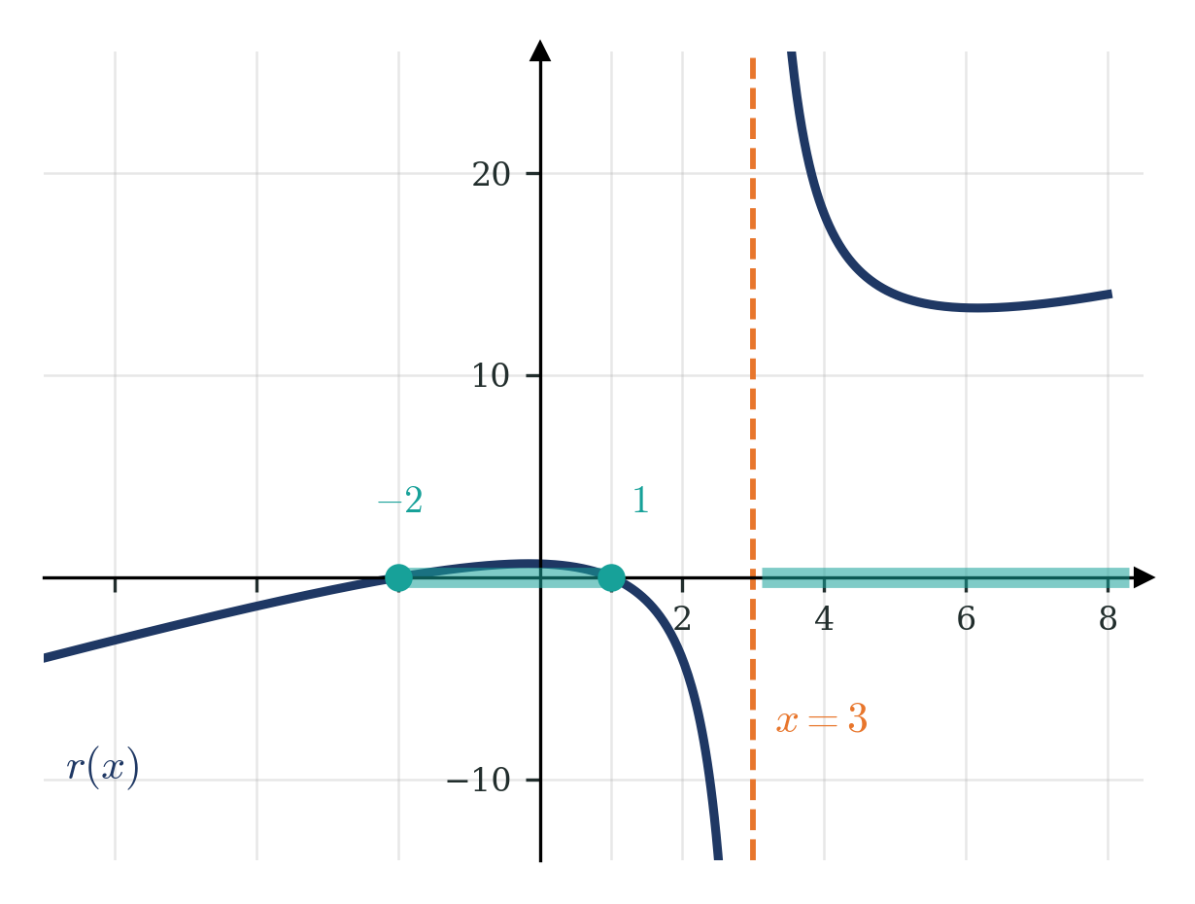
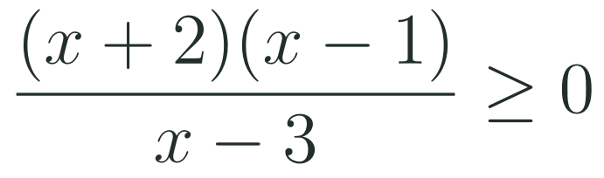
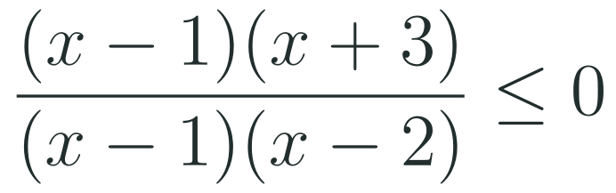

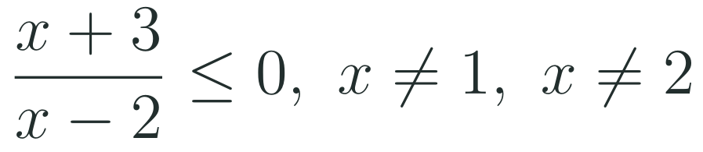

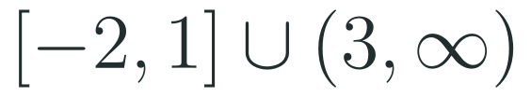

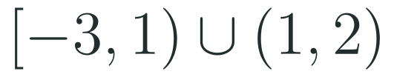
1
2
3
4
5
6
STATION 2 · TARGETED INSTRUCTION · 18 MIN
Sign charts and inequalities
EXAMPLE A
EXAMPLE B
LO 1.8.A
FAITH, RIGHTEOUSNESS AND WISDOM
Mr Malek Thiab · 7
Notes:
Speaker notes (Targeted Instruction, block 3 of 3):
Speaker notes (Targeted Instruction, block 3 of 3, LO 1.8.A). EK 1.8.A.2 as printed in the CED text I could fetch (partly garbled, check against the CED PDF): 'The real zeros of both polynomial functions of a rational function r are endpoints or asymptotes for intervals satisfying the rational function inequalities r(x) >= 0 or r(x) <= 0.' The sentence appears to refer to the numerator and denominator.
Worked solutions: Example A (graph on the slide): boundaries are the numerator zeros -2 and 1 and the denominator zero 3. Test x = -3: (-1)(-4)/(-6) = -2/3, negative. Test x = 0: (2)(-1)/(-3) = 2/3, positive. Test x = 2: (4)(1)/(-1) = -4, negative. Test x = 4: (6)(3)/1 = 18, positive. r(x) >= 0 on [-2, 1] (zeros included, closed) and on (3, infinity) (x = 3 is a vertical asymptote, never included). Example B: cancel x - 1 but keep x not equal to 1. Then (x + 3)/(x - 2) <= 0: test x = -4: (-1)/(-6) positive; x = 0: 3/(-2) negative; x = 3: 6/1 positive. So -3 <= x < 2, and x = 1 is removed because r(1) is undefined: [-3, 1) union (1, 2).
Verbal misconceptions: 'include the endpoint where the denominator is zero'; 'the sign alternates at every boundary' (it does not change across a hole, and an even-multiplicity zero keeps the sign); 'cancelled factors can be forgotten when writing the answer'.
Adaptive routing: if more than 30% miss Gate Q3, return to this slide and rebuild the sign chart for Example A on the board. If students include x = 3 in Example A, remind them that the denominator is zero there.

Slide 8
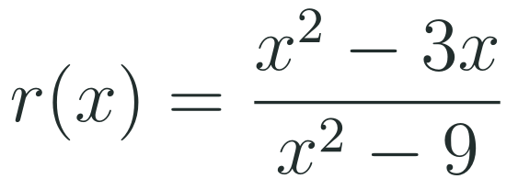
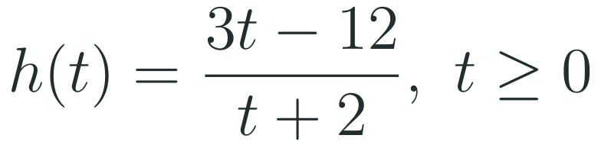
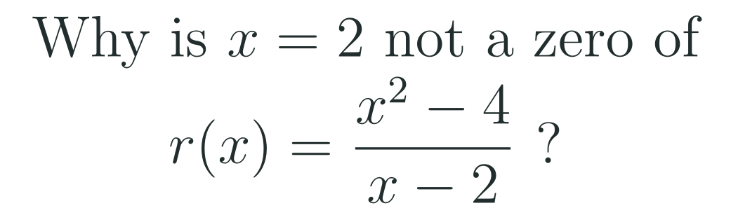
1
2
3
4
5
6
STATION 3 · PRACTICE · 12 MIN
Give it a go: Practice, Apply, Investigate
PRACTICE
APPLY
INVESTIGATE
Secure the method
Use it in context
Find out why
Done when: you factor both parts, state every real zero, and say what happens at the other zero of the numerator.
Done when: you find when h is zero and state the sign of h before that time using a test value.
Done when: your explanation names the domain, gives the actual zero, and gives the coordinates of the hole.
LO 1.8.A
FAITH, RIGHTEOUSNESS AND WISDOM
Mr Malek Thiab · 8
Notes:
Speaker notes (Practice, 12 min; tierless differentiation: students choose the starting column and may move across):
Speaker notes (Practice, 12 min; tierless: students choose the starting column and may move across).
Answers: Practice: x^2 - 3x = x(x - 3) and x^2 - 9 = (x - 3)(x + 3), so r(x) = x/(x + 3) with x not equal to 3. The numerator is zero at x = 0 and x = 3; x = 3 is not in the domain (hole at (3, 1/2)), so the only zero is x = 0. Apply: 3t - 12 = 0 gives t = 4, and the denominator is 6 there, so h(4) = 0. At t = 0: h(0) = -12/2 = -6, negative, and the sign does not change before t = 4, so h is negative on 0 <= t < 4. Investigate: (x^2 - 4)/(x - 2) = (x - 2)(x + 2)/(x - 2); the denominator is zero at x = 2, so 2 is not in the domain; the actual zero is x = -2, and the graph is the line y = x + 2 with a hole at (2, 4).
Use 'done when' as a prompt in the 'Apply' column: ask what the zero of h means in a story you invent.
Verbal misconceptions: 'if the numerator is zero the function is zero'; 'cancelling removes the problem at x = 3'.
Adaptive routing: finished students move to Apply then Investigate; stuck students return to slide 5 Example B.

Slide 9
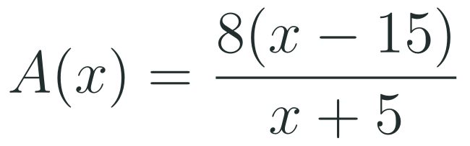

1
2
3
4
5
6
STATION 4 · PRODUCTION · 12 MIN
Production: break-even at a tile studio in Lisbon
THE MODEL
DONE WHEN
A tile studio in Lisbon sells hand-painted tile sets. The model gives the average profit per set, in euros, when x sets are sold in a week, after the studio's weekly fixed costs are spread over the sets. All numbers are model values for practice, not real accounts.
The zero is found from the numerator and checked against the domain.
The sign chart shows a test value for each interval.
Both the negative and positive intervals are written as inequalities.
The equation for 4 euros is solved and the answer checked in A.
Find the zero of A and say what it means for the studio.
Use a sign chart to state when the average profit per set is negative and when it is positive.
Find how many sets give an average profit of exactly 4 euros per set.
Hint: the denominator is positive for every x in the domain, so the sign of A comes from the numerator alone.
LO 1.8.A
FAITH, RIGHTEOUSNESS AND WISDOM
Mr Malek Thiab · 9
Notes:
Speaker notes (Production, 12 min):
Speaker notes (Production, 12 min).
Solutions: Task 1: 8(x - 15) = 0 gives x = 15; the denominator is 20 there, so x = 15 is a zero. At 15 sets per week the average profit per set is zero euros: the studio breaks even. Task 2: the only boundary inside x >= 1 is 15 (x = -5 is outside the domain of the context). Test x = 1: 8(-14)/6 = -56/3, about -18.67, negative. Test x = 20: 8(5)/25 = 1.6, positive. So A(x) < 0 for 1 <= x < 15 and A(x) > 0 for x > 15. Task 3: 8(x - 15)/(x + 5) = 4 gives 8x - 120 = 4x + 20, so 4x = 140 and x = 35. Check: 8(20)/40 = 4.
Verbal misconceptions: 'the zero of the denominator, x = -5, is also a break-even point'; 'multiplying through by x + 5 can change the answer' (it is allowed because x + 5 is not zero); 'negative profit means the studio should stop' (the model shows the loss shrinking as sales grow).
Adaptive routing: if students cannot start, send them to slide 5 Example A and the hint. If Task 2 stalls, send them to slide 7 Example A.

Slide 10
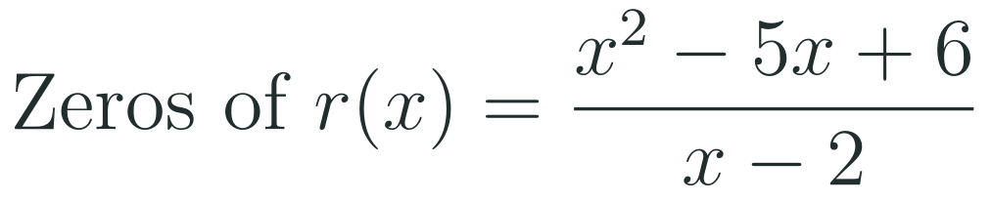
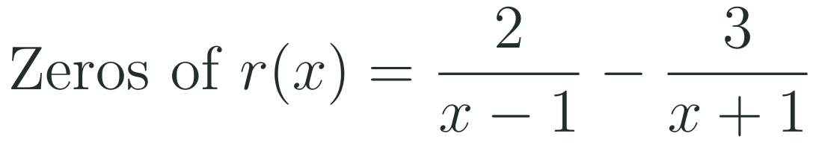
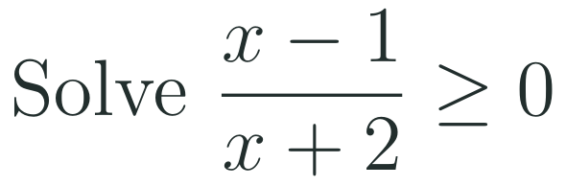
1
2
3
4
5
6
STATION 5 · MASTERY GATE · 6 MIN
Mastery Gate: three questions to pass
1
2
3
Pass mark
3 of 3 correct unlocks Station 6. Fewer than that: return to the slide for the question you missed, redo it, then re-take the gate.
LO 1.8.A
FAITH, RIGHTEOUSNESS AND WISDOM
Mr Malek Thiab · 10
Notes:
Speaker notes (Mastery Gate, 6 min, no calculator):
Speaker notes (Mastery Gate, 6 min, no calculator).
Answers: Q1 x^2 - 5x + 6 = (x - 2)(x - 3); the numerator is zero at 2 and 3, but x = 2 makes the denominator zero, so the only zero is x = 3 (hole at (2, -1)). Q2 combine: (2(x + 1) - 3(x - 1))/((x - 1)(x + 1)) = (5 - x)/((x - 1)(x + 1)); the zero is x = 5. Q3 boundaries -2 and 1; test x = -3: (-4)/(-1) = 4, positive; x = 0: -1/2, negative; x = 2: 1/4, positive. Solution (-infinity, -2) union [1, infinity).
Verbal misconceptions: Q1 'zeros are 2 and 3'; Q2 'the zero is where each fraction is zero' or 'x = 1 and x = -1'; Q3 'include -2' or 'answer [-2, 1]'.
Adaptive routing: Q1 missed, route to slide 5 Example B; Q2 missed, route to slide 6 Example A; Q3 missed, route to slide 7 Example A.

Slide 11
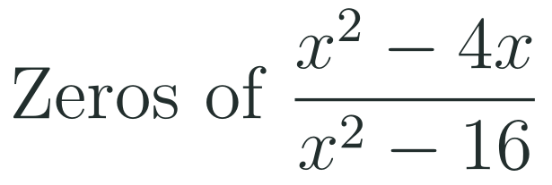
1
2
3
4
5
6
STATION 6 · SMART PRODUCTION · 6 MIN
Smart Production: make one, then check it
CREATE
TIME TO CHECK
Write a rational function in factored form with zeros at x equal to negative 2 and 5, a hole where x is 1, and a vertical asymptote where x is negative 3.
Expand nothing: write the domain and the list of zeros directly from the factored form.
Swap with a partner: they check the zeros against the domain and find the hole.
Exit ticket: write your answer on a sticky note and place it on the door.
Done when: your partner confirms the two zeros, the hole and the asymptote from the factored form.
Next lesson: Topic 1.9 Rational Functions and Vertical Asymptotes.
LO 1.8.A
FAITH, RIGHTEOUSNESS AND WISDOM
Mr Malek Thiab · 11
Notes:
Speaker notes (Smart Production, 6 min):
Speaker notes (Smart Production, 6 min).
Create example: r(x) = (x + 2)(x - 5)(x - 1)/((x - 1)(x + 3)): zeros -2 and 5, hole at x = 1 (value (3)(-4)/(4) = -3, so the hole is (1, -3)), asymptote x = -3. Exit answer: x(x - 4)/((x - 4)(x + 4)); the numerator is zero at 0 and 4, but 4 is not in the domain (hole at (4, 1/2)); the only zero is x = 0.
Verbal misconceptions: students list 0 and 4; ask: is r(4) defined?

Slide 12
Journey complete
Targeted Instruction
Production
Smart Production
✓
✓
✓
✓
✓
✓
Diagnose
Practice
Mastery Gate
A zero of a rational function is a zero of the numerator that is also in the domain, and the zeros of the numerator and denominator are the boundaries when solving a rational inequality.
FAITH, RIGHTEOUSNESS AND WISDOM
Notes:
Speaker notes: Every station is checked off. Recap in one sentence: A zero of a rational function is a zero of the numerator that is also in the domain, and the zeros of the numerator and denominator are the boundaries when solving a rational inequality. Collect the Time to Check responses. Next lesson: Topic 1.9 Rational Functions and Vertical Asymptotes.

